Slide 1
ASTRA & FIPA-ACL
Lecturer: Rem Collier
Email: rem.collier@ucd.ie

Slide 2
FIPA ACL & ASTRA
ASTRA uses FIPA ACL for its message format
It does not attempt to adhere to the FIPA infrastructure standards
Nor does it attempt to comply with the underlying formal model for the ACL
ASTRA supports communication through:
Message Events:
@message(<performative>, <sender>, <content>)
The Send Plan Operator:
send(<performative>, <receiver>, <content>)
Agents are written using standard ASTRA code + these extra bits…

Slide 3
A Simple Example: Ping-Pong
The ping-pong protocol is a simple but highly useful protocol (think health monitoring):
Agent A sends a ping request message to Agent B
Agent B responds with a pong inform message.
If we keep doing this on a regular basis, we have a heartbeat…
Agent A
Agent B
request, ping
inform, pong

Slide 4
A Simple Example: Ping-Pong
The ping-pong protocol is a simple but highly useful protocol (think health monitoring):
Agent A sends a ping request message to Agent B
Agent B responds with a pong inform message.
If we keep doing this on a regular basis, we have a heartbeat…
Pong
Ping
request, ping
inform, pong

Slide 5
Astra: Ping-Pong
agent Ping {
module System system; module Console console;
rule @message(request, string sender, ping()) {
console.println("ping");
system.sleep(500);
send(inform, sender, pong());
}
}
agent Pong {
module System system; module Console console;
rule @message(inform, string sender, pong()) {
console.println("pong");
system.sleep(500);
send(request, sender, ping());
}
}

Slide 6
Astra: Ping-Pong
agent Ping {
module System system; module Console console;
rule @message(request, string sender, ping()) {
console.println("ping");
system.sleep(500);
send(inform, sender, pong());
}
}
agent Pong {
module System system; module Console console;
rule @message(inform, string sender, pong()) {
console.println("pong");
system.sleep(500);
send(request, sender, ping());
}
}
Who starts the conversation?

Slide 7
Astra: Ping-Pong
agent Ping {
module System system; module Console console;
rule @message(request, string sender, ping()) {
console.println("ping");
system.sleep(500);
send(inform, sender, pong());
}
}
agent Pong {
module System system; module Console console;
rule @message(inform, string sender, pong()) {
console.println("pong");
system.sleep(500);
send(request, sender, ping());
}
}
Who starts the conversation?
More importantly, how do we create these agents?

Slide 8
Creating Agents with ASTRA
The astra.lang.System library comes with built in support for creating agents:
System.createAgent(<name>, <agent-class>);
A Basic Replicator:
agent Replicator {
module System system;
module Console console;
rule +!main(list args) {
console.println(”Created: “ + system.name());
string name = system.name()+”1”;
system.createAgent(name, “Replicator”);
system.setMainGoal(name, []);
}
}

Slide 9
Launching Ping-Pong
agent Main {
module System system;
rule +!main(list args) {
system.createAgent(“ping”, “Ping”);
system.createAgent(“pong”, “Pong”);
system.setMainGoal(“pong”, [“ping”]);
}
}

Slide 10
Modified Pong Agent…
agent Pong {
module System system;
module Console console;
rule +!main([string target]) {
send(request, target, ping());
}
rule @message(inform, string sender, pong()) {
console.println("pong");
system.sleep(500);
send(request, sender, ping());
}
}

Slide 11
One More Problem…
The ASTRA Ping and Pong programs will not work:
ASTRA requires that the content of any message to be declared in a types statement:
types pp {
formula ping();
formula pong();
}
This statement needs to be replicated in every agent class that participates in the protocol…
Luckily, ASTRA has an inheritance mechanism to simplify this…
It’s actually a multiple-inheritance model, but let’s not get too caught up for now…

Slide 12
Astra: Ping-Pong
agent PingPong {
types pp {
formula ping();
formula pong();
}
module Console console;
module System system;
}

Slide 13
Astra: Ping-Pong
agent Pong extends PingPong {
rule +!main([string target]) {
send(request, target, ping());
}
rule @message(inform, string sender, pong()) {
console.println("pong");
system.sleep(500);
send(request, sender, ping());
}
}
agent Ping extends PingPong {
rule @message(request, string sender, ping()) {
console.println("ping");
system.sleep(500);
send(inform, sender, pong());
}
}

Slide 14
More Complex Protocols

Slide 15
ASTRA and Extended Plan Syntax
Core programming constructs in ASTRA include:
if statement the most basic form of ﬂow control
while loop usual method of repetition in programming
foreach loop repeats the same actions for every matching binding of a formula
forall loop repeats the same actions for all the values in a specified list.
try ... recover allows for the recovery from failed actions
Local variable declarations for use within a plan rule
assignment allows the value of a local variable to be changed
query binds the values of beliefs to variables
wait pauses execution until condition if true
send sends message to another agent
synchronized enables mutual exclusion in critical sections

Slide 16
FIPA Request Protocol

Slide 17
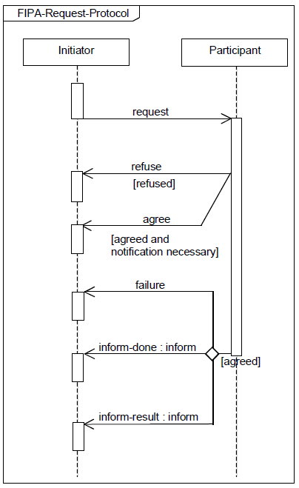
FIPA Request Protocol
Initiator requests that some task be performed
Participant either agrees to or refuses the request
Participant performs the task and tells the initiator:
Of the failure of the task
That the task is done
The result of the task

Slide 18
Example: Requesting a Beer
A Beer Drinker wants another beer
They ask (request) the server for one
The Server responds:
If it has the beer, it agrees to give the beer, which it then gets from the fridge and delivers.
Otherwise, it refuses the request
If the Server makes a mistake the request fails:
The server cannot get the beer
The server fails to deliver the beer

Slide 19
Example: Requesting a Beer
agent BeerOntology {
// Formulae used in the protocol
types beer {
formula get(string);
formula got(string);
}
module Console C;
}

Slide 20
Example: Requesting a Beer
formula get(string);
formula got(string);
agent BeerServer extends BeerOntology {
types server {
formula has(string);
}
initial has(“beer”);
rule @message(request, string sender, get(string X)) {
if (~has(X)) send(refuse, sender, get(X));
else {
send(agree, sender, get(X));
try {
!get(X);
!deliver(X, sender);
send(inform, sender, got(X));
} recover {
send(failure, sender, get(X));
}
}
}

Slide 21
Example: Requesting a Beer
rule +!get(string X) {
C.println("Got beer");
}
rule +!deliver(string X, string sender) {
C.println("Delivered: " + X + " to: " + sender);
}
}

Slide 22
Example: Requesting a Beer
formula get(string);
formula got(string);
agent BeerDrinker extends BeerOntology {
types drinker {
formula failed_to_get(string);
}
rule +!main([string server]) {
send(request, server, get(“beer”));
}
rule @message(agree, string sender, get(“beer”)) {
wait(got(“beer”) | failed_to_get(“beer”));
if (got(“beer”)) C.println(“Yummy in my tummy!”);
}
rule @message(inform, string sender, got(“beer”)) {
+got(“beer”);
}
rule @message(failure, string sender, get(“beer”)) {
+failed_to_get(“beer”);
}
}

Slide 23
Example: Requesting a Beer
agent Main {
module System system;
rule +!main(list args) {
system.createAgent("server", "BeerServer");
system.createAgent("drinker", "BeerDrinker");
system.setMainGoal("drinker", ["server"]);
}
}

Slide 24
FIPA Subscribe Protocol

Slide 25
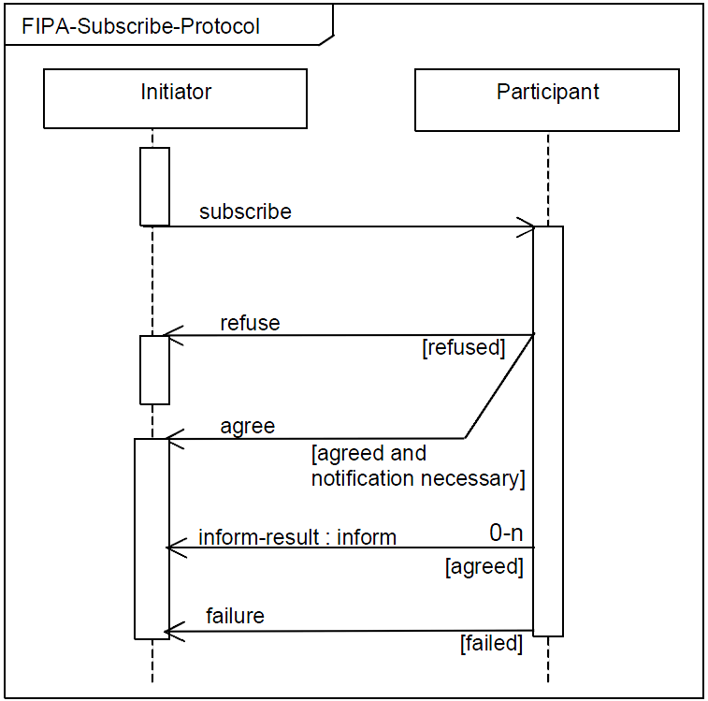
Example: FIPA Subscribe Protocol
Initiator subscribes to the participant.
Participant either agrees or refuses subscription
Participant informs initiator of any information relating to the subscription or sends a failure message if necessary.

Slide 26
Example: A Book Service
A Bookshop provides a service that advertises new books
Interested agents can subscribe to the “new_books” service.
Each time a new book is released, all subscribed agents are informed of it.

Slide 27
Example: A Book Service
agent BookOntology {
// Formulae used in the protocol
types books {
// used in service subscription
formula book_service();
// used when a new book is released (author and title)
formula book(string, string);
}
module Console C;
}

Slide 28
Example: A Book Service
agent Bookshop extends BookOntology {
types shop {
formula subscriber(string);
formula new_book(int, string, string);
}
rule @message(subscribe, string sender, book_service())
: subscriber(sender) {
send(refuse, sender, book_service());
}
rule @message(subscribe, string sender, book_service()) {
send(agree, sender, book_service());
+subscriber(sender);
}
rule +!book(string author, string title) {
foreach (subscriber(string name)) {
send(inform, name, book(author, title));
}
}

Slide 29
Example: A Book Service
module System system;
initial !tick(0);
rule +!tick(int time) {
C.println(”time: ” + time);
foreach(new_book(time, string author, string title)) {
!book(author, title);
}
system.sleep(500);
!tick(time+1);
}
initial new_book(3, “JK Rowling”,
“Harry Potter and the Philopsophers Stone”);
}

Slide 30
Example: A Book Service
agent BookLover extends BookOntology {
types lover {
formula subscribed(string);
}
rule +!main([string sender]) {
send(subscribe, sender, book_service());
}
rule @message(agree, string sender, book_service()) {
+subscribed(sender);
}
rule @message(inform, string sender,
book(string author, string title)) : subscribed(sender) {
C.println(“New Book: “ + title + “ by: “ + author);
}
}

